Slide 1
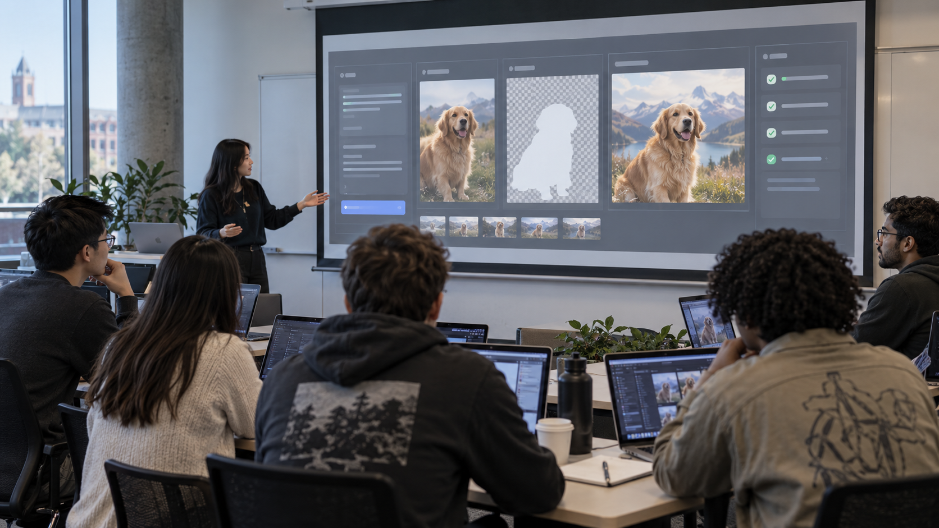
Image Generation
and Editing APIs
From beautiful pixels to controlled visual workflows.
No private assets
Workflow-first
API-ready
04
Notes:
Open with the difference between beautiful and production-ready. Product can look good and still be wrong.

Slide 2

HOOK
The trap: pretty does not mean usable
A generated image can fail silently:
01
The product shape changed
02
The logo or label drifted
03
The image implies a false claim
04
Rights or privacy are unclear
05
No one can reproduce the result
GenAI Basics · Lecture 04
Notes:
Ask students: if it looks good, what can still be wrong? Then reveal these answers.

Slide 3
MENTAL MODEL
Professional image generation is a workflow
Inputs
Controls
Model/API
Variants
Review
Approved
prompt
refs
mask
size
style
safety
generate
or edit
3-8
outputs
quality
rights
brand
store
and publish
The model is only one box in the system. Production quality comes from controls before generation and review after generation.
GenAI Basics · Lecture 04
Notes:
Point out the middle box: model/API. Everything around it is the engineering system.

Slide 4
TERMS
The vocabulary you need
Text-to-image
image from words
Outpainting
extend canvas
Image-to-image
transform an input image
Reference image
guide identity/style/layout
Inpainting
edit selected area
Mask
where edits are allowed
Acceptance criteria decide whether the output can leave the classroom and enter a real workflow.
GenAI Basics · Lecture 04
Notes:
Use mug examples for every term; avoid art jargon.

Slide 5
PROMPTING
Prompt anatomy: a production brief, not a poem
Subject
what must appear
Core instruction
Create a 16:9 ecommerce hero image for a speckled ceramic mug on a warm kitchen counter.
Composition
angle, crop, framing
Scene
place, light, materials
Style
photo, illustration, UI, comic
This says what to create, but not enough to control production quality.
References
what each input controls
Constraints
what must not change
Acceptance
how to judge pass/fail
The most important line is often: what must not change.
GenAI Basics · Lecture 04
Notes:
Spend time on constraints and acceptance. This is where students become more professional than prompt hobbyists.

Slide 6
BEFORE / AFTER
Weak prompt vs controlled workflow prompt
Weak
Controlled
“Make a beautiful ad image for this mug.”
Keep product unchanged. Edit only background. 16:9. No text, no people. Return 3 variants. Acceptance: geometry unchanged, natural light, review before publish.
Likely failure: random background, changed product, no review criteria, no metadata.
This prompt can be reviewed, debugged, and repeated as a workflow.
GenAI Basics · Lecture 04
Notes:
This is the core teaching contrast.

Slide 7
REFERENCES
Reference images: decide what each one controls
Identity
Style
Layout
Content
same product, person, object
lighting, palette, mood
pose, camera, composition
what elements must appear
A reference image is not “extra inspiration.” It is a control signal. Say what it controls.
GenAI Basics · Lecture 04
Notes:
Students often upload references without telling the model what to preserve.

Slide 8
EDITING
Editing modes: inpaint, outpaint, variation
Original
Inpaint
Outpaint
Variants
GenAI Basics · Lecture 04
Notes:
Use the mug as an anchor. Editing is controlled change, not just generation.

Slide 9
API FLOW
API lifecycle: the boring parts make it useful
1
Prepare assets
2
Build request
3
Call endpoint
4
Receive job/result
5
Save output
6
Review + publish
Store metadata: provider, model, prompt, input asset IDs, output file, timestamp, review status, risk notes.
GenAI Basics · Lecture 04
Notes:
This is where APIs differ, but the lifecycle remains stable.

Slide 10
LANDSCAPE
Provider examples: compare capabilities, not hype
OpenAI Images
Gemini / Nano Banana
Adobe Firefly Services
generation + edits
Images / Responses API
conversational image
generation + editing
creative-suite and
production media APIs
Question that survives model churn: what input, what edit control, what output, what rights, what review?
GenAI Basics · Lecture 04
Notes:
Mention sources checked, but avoid a vendor ranking.

Slide 11
DECISION
Selection matrix for real work
Need
Choose for
Fast concepts
speed, variants, low friction
Product edits
reference fidelity, masking
Campaign assets
brand controls, approval flow
Enterprise use
privacy, rights, audit, cost
Text-heavy graphics
usually deterministic design tools
If exact layout or text matters, generate the concept then rebuild the final asset in editable tools.
GenAI Basics · Lecture 04
Notes:
This slide prevents students from trying to use image models for everything.

Slide 12
API EXAMPLE
OpenAI image API shape
Images API
Responses API
Production note
Generate images from text.
Edit existing images from source image(s) and prompt.
Use current docs for exact model, endpoint and access requirements.
Image generation can be used as a tool inside a broader response workflow.
Useful when text reasoning, images and tools must work together.
Organization access, supported models, file limits and pricing change.
Check official docs on delivery day.
GenAI Basics · Lecture 04
Notes:
Keep this current and conservative.

Slide 13
PYTHON
Code shape: generate, save, record metadata
prompt = build_prompt(spec)
request = { model, prompt, size, references, mask }
result = image_api.generate_or_edit(request)
file = save_image(result.bytes)
write_metadata(prompt, model, inputs, file, review="draft")
The important code is not only the API call. It is storage, metadata, review status and failure handling.
GenAI Basics · Lecture 04
Notes:
Show the demo repo skeleton. Students do not need to run it.

Slide 14
OPERATIONS
Cost and reliability controls
Variant limit
Do not generate 20 images when 3 are enough.
Queue/poll
Use async jobs where provider requires it.
Retry carefully
Avoid paying twice for preventable failures.
Cache outputs
Reuse approved assets and prompts.
Human review
Do not publish directly from model output.
GenAI Basics · Lecture 04
Notes:
Image APIs are heavier than text APIs. This introduces production thinking.

Slide 15
GOVERNANCE
Safety, rights and provenance
Privacy
Rights
faces, private places, unreleased products
brands, characters, protected styles
Misleading content
Provenance
fake evidence, false scenes, implied claims
prompt, inputs, model, date, reviewer
Rule for students: use safe fictional assets unless the environment and rights are clear.
GenAI Basics · Lecture 04
Notes:
State boundaries before the live demo.

Slide 16

DEMO
Live demo: weak -> structured -> controlled
1 Weak
“Make a beautiful ad image.”
2 Structured
subject, scene, lighting, size, negatives
3 Controlled
reference, mask, constraints, acceptance
Do not chase a perfect output. Teach how control changes the result.
GenAI Basics · Lecture 04
Notes:
Run browser first. If it fails, use failure as a lesson.

Slide 17
PRACTICE
Workshop: Image Generation Workflow Spec
Goal + channel
Source assets
Reference strategy
Prompt + controls
Acceptance criteria
Risks + review
Metadata to store
Do not automate
The artifact is reusable: it can feed later API, agent and capstone modules.
GenAI Basics · Lecture 04
Notes:
Give 12-15 minutes. Require one group to present tradeoffs.

Slide 18
HOMEWORK
What students should submit
01
Workflow Spec
completed template
02
Prompt iteration log
weak -> improved -> controlled
03
Review checklist
what passed, what failed
04
Boundary statement
what must not be automated
Use fictional or safe assets. No real private photos, copyrighted characters, or uncontrolled brand work.
GenAI Basics · Lecture 04
Notes:
Homework makes them create a spec, not a decorative output.

Slide 19
QA
Quality checklist before publishing an AI image
Object unchanged where required
No unwanted text, logos, hands or extra products
Lighting and shadows plausible
Rights and privacy clear
Prompt + model + input IDs stored
Human approval recorded
GenAI Basics · Lecture 04
Notes:
This mirrors the QA gates in the course production process.

Slide 20
WRAP
Takeaways
1
Image generation is controlled workflow design, not prompt roulette.
2
References and masks are control tools.
3
Acceptance criteria matter more than pretty outputs.
4
APIs need storage, metadata, review and cost controls.
5
Next: video generation models and APIs.
GenAI Basics · Lecture 04
Notes:
Point forward to video generation.

